Slide 1


Lecture #0

Slide 2

CAP770
ADVANCED DATA STRUCTURES
The Kick Start Session

Slide 3
Course details
L T P – 3 0 2
Textbook
DATA STRUCTURES AND ALGORITHMS IN C++ by ADAM DROZDEK, THOMSON EDUCATIONAL PUBLISHING

Slide 4
Course Assessment Model
Marks break up
Attendance 05
CAP(Three best out of Four Practical) 45
MTE 00
ETP 50
Total 100

Slide 5

The hitch…
Three BURNING questions in mind…
Why we are learning ADVANCED DATA STRUCTURES?
What would we do with it?
What will the course outcome?

Slide 6
Why Advanced Data Structure
It teaches you the science of evaluating the efficiency of an algorithm.
This enables you to choose the best of various choices.
It creates a platform for cracking the technical rounds in interviews
Being a part of UGC/NET exams , it is very important part of an academician

Slide 7
What we do it with?
Choosing the best optimal solution of a particular problem domain
Choosing alternate approach to solve a particular problem domain if we stuck with existing one
Understand the real life problem domains and solution of those problems

Slide 8
The course contents
Unit I
Introduction: need of data structures and algorithms, time and space complexity of algorithms, asymptotic notations, average and worst case analysis, arrays vs linked lists, operations on arrays and linked lists.
Unit II
Stacks and queues: implementation of stacks, applications of stacks: quick sort, parenthesis checker, arithmetic expression conversion and evaluation, tower of Hanoi problem, role of stack in recursion, implementation of queues, priority queue, applications of queues
Unit III
Search trees: binary search trees: searching, insertion and deletion operations, AVL trees: balancing operations, b-trees: properties and operations, red-black trees, splay trees: properties and operations, 2-3 trees: properties and operations.

Slide 9
The course contents…continued
Unit IV
Heaps: introduction to heaps, min heap, max heap, operations on heap, applications of heap: priority queue implementation, heap sort, binomial heaps, Fibonacci heaps
Unit V
Graphs: type of graphs, adjacency matrix and linked adjacency chains, connected components and spanning trees, breadth first search, depth first search, network flow problems, warshall's algorithm for shortest path, topological sort
Unit VI
Hashing techniques: linear list representation, hash table representation, hash functions, collision resolution-separate chaining, open addressing-linear probing, quadratic probing, double hashing, rehashing.

Slide 10
The course outcome…
Perceive advanced data structures and perform operations on them
Understand abstract data types and algorithmic complexity
Apply suitable data structure for solving problems
Implement hashing and collision resolution techniques
Evaluate the performance of various algorithms

Slide 11

Next : Introduction to Data Structure and Algorithms

Slide 12
Poll
What is the L T P of the course :
3 0 0
3 0 2
2 0 3
0 0 3

Slide 13
Algorithm
An algorithm is a step-by-step procedure for solving a problem in a finite amount of time.

Slide 14
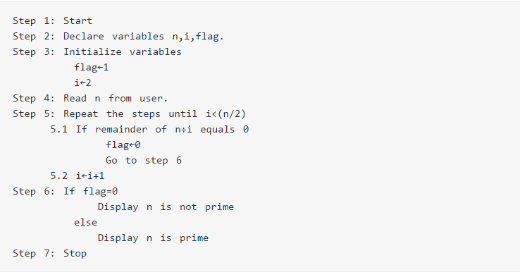
Example
Algorithm to check whether a number entered by user is prime or not.

Slide 15
Code……
?

Slide 16
Write an algorithm to find the Fibonacci series till term≤1000

Slide 17
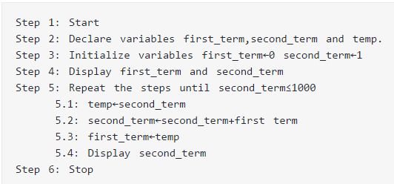

Slide 18
Code
?

Slide 19
Data Structures
A data structure is a specialized format for organizing and storing data .
General data structure types include the array, the file, the record, the table, the tree, and so on
Any data structure is designed to organize data to suit a specific purpose so that it can be accessed and worked with in appropriate ways.

Slide 20
Some Examples of Data structures
There are numerous types of data structures, generally built upon simple primitive data type
Primitive types
Composite types or Non-primitive type
Abstract data types

Slide 21
Primitive types
Boolean, true or false.
Character
Floating-point, single-precision real number values.
Double, a wider floating-point size.
Integer, integral or fixed-precision values.
String, a sequence of characters.
Reference (also called a pointer or handle), a small value referring to another object's address in memory, possibly a much larger one.
Enumerated type, a small set of uniquely named values.

Slide 22
Composite types or Non-primitive type
(aggregate data type)
Array
Record (also called tuple or structure)
Union
Tagged union (also called variant, variant record, discriminated union, or disjoint union)

Slide 23
Abstract data types
Container
List
Associative array
(associative array, map, symbol table, or dictionary is an abstract data type composed of a collection of (key, value) pairs, such that each possible key appears at most once in the collection.)
Multimap
(a multimap (sometimes also multihash or multidict) is a generalization of a map or associative array abstract data type in which more than one value may be associated with and returned for a given key)

Slide 24
Continue…..
Set
Multiset (Bag)
Stack
Queue
Double-ended queue
Priority queue
Tree
Graph

Slide 25

Linear data structures
Array
Linked List
Stack
Queue
Tree
Graph

Slide 26
Poll
Array falls under which data type?
Primitive
Non-Primitive
Abstract
All
© LPU :: CAP659 Programming in C# :: Sumit Gupta

Slide 27


